Slide 1

Emotion Detection from Text: A Machine Learning Project
This presentation outlines our machine learning project.
Our goal is to detect emotions in text. We will explore various models and tools. This includes Linear Regression, Naive Bayes, Random Forest and SVC.
by- Rohit Verma

Slide 2
Data Collection and Preprocessing
Dataset Overview
Emotion Categories
Data Cleaning
Our dataset contains 34,792 labeled sentences. It's taken from an online source.
Joy
We use Neattext to clean the data.
Sadness
Remove hashtags
Fear
Remove URLs
Size: 34,792 sentences
Anger
Remove special characters
Labels: 8 emotions
Surprise
Neutral
Disgust
Shame

Slide 3





Feature Extraction
Text Data
Raw text inputs
Bag of Words
Create a vocabulary
Count Vectorizer
Matrix of token counts
Numerical Data
Model-ready features

Slide 4

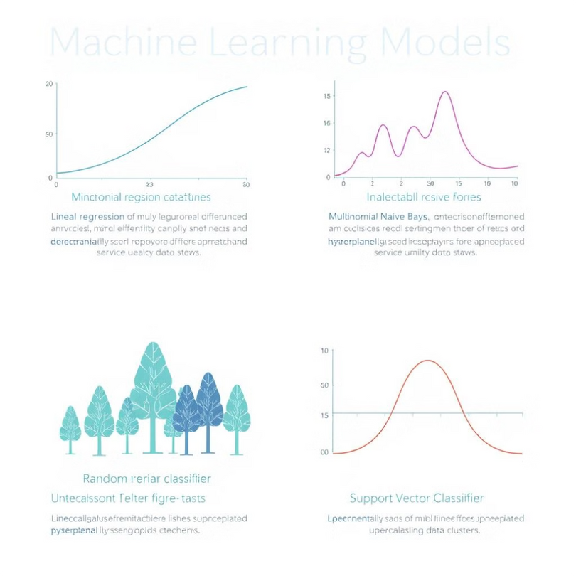

Model Selection and Training
Linear Regression
Baseline comparison
Multinomial Naive Bayes
Probabilistic classifier
Random Forest
Ensemble of decision trees. Number of trees: 100 Max depth: 10
Support Vector Classifier (SVC)
Linear and RBF kernels. Regularization parameter (C): 1.0

Slide 5

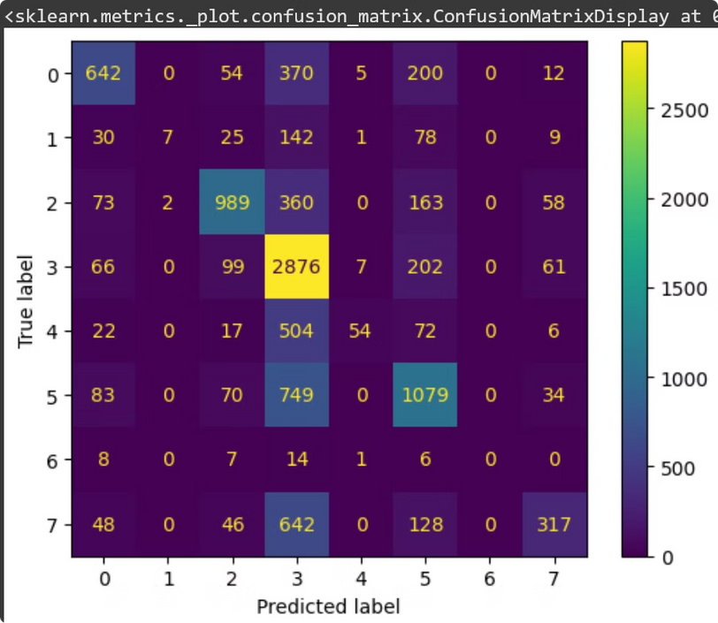
Model Evaluation
Accuracy
(TP + TN) / (Total)
Precision
TP / (TP + FP)
Recall
TP / (TP + FN)
F1-Score
2 * (Precision * Recall) / (Precision + Recall)

Slide 6
Model Persistence
Saving the Model
Loading the Model
import joblib
joblib.dump(model, 'emotion_detection_model.joblib')
loaded_model = joblib.load('emotion_detection_model.joblib')

Slide 7

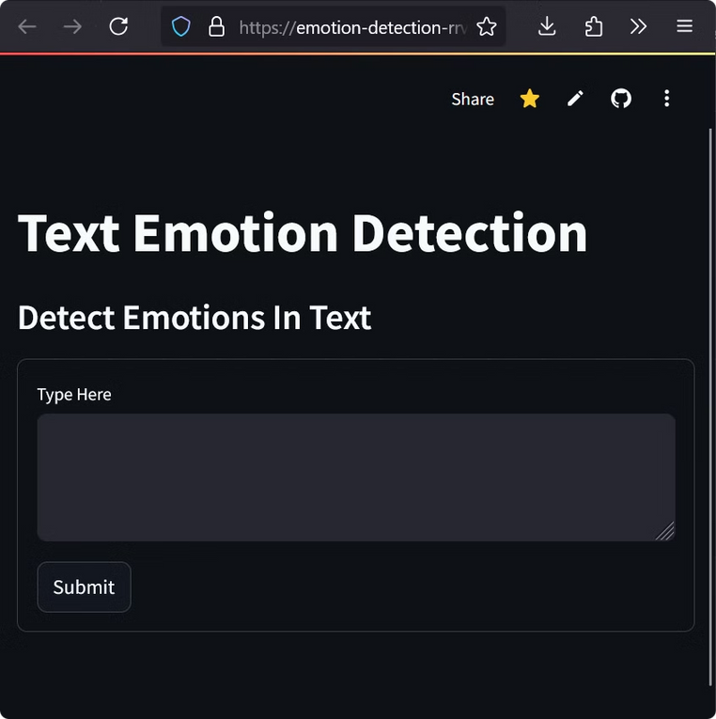



Streamlit App Deployment
Interactive UI
Text Input
User enters text
Emotion Detection
Predicted emotion displayed

